Slide 2
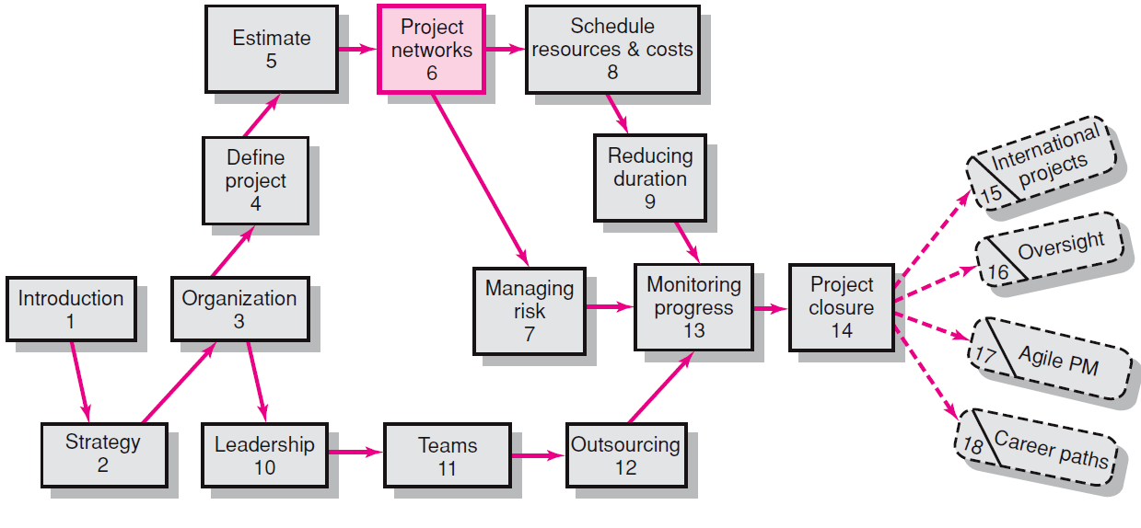
Where We Are Now
6–<number>

Slide 3
Developing the Project Plan
The Project Network
  A flow chart that graphically depicts the sequence, interdependencies, and start and finish times of the project job plan of activities that is the critical path through the network.
    Provides the basis for scheduling labor and equipment.
    Enhances communication among project participants.
    Provides an estimate of the project’s duration.
    Provides a basis for budgeting cash flow.
    Identifies activities that are critical.
    Highlights activities that are “critical” and can not be delayed.
    Help managers get and stay on plan.
6–<number>

Slide 4
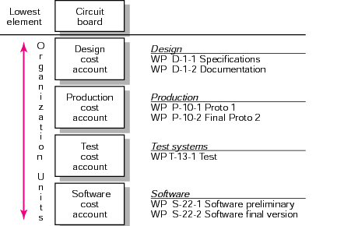
From Work Package to Network
WBS/Work Packages to Network
FIGURE 6.1
Copyright © 2006 The McGraw-Hill Companies. All rights reserved.
McGraw-Hill/Irwin 6–<number>

Slide 5
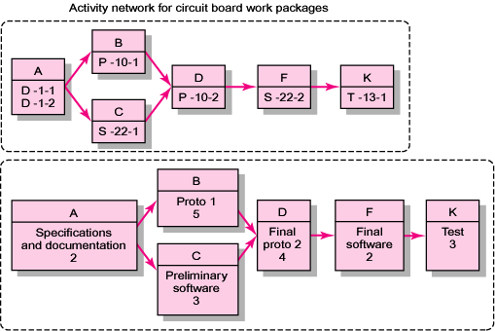
From Work Package to Network (cont’d)
WBS/Work Packages to Network (cont’d)
FIGURE 6.1 (cont’d)
Copyright © 2006 The McGraw-Hill Companies. All rights reserved.
McGraw-Hill/Irwin 6–<number>

Slide 6
Constructing a Project Network
Terminology
  Activity: an element of the project that requires time.
  Merge Activity: an activity that has two or more preceding activities on which it depends.
  Parallel (Concurrent) Activities: Activities that can occur independently and, if desired,
  not at the same time.
A
B
D
C
6–<number>

Slide 7
Constructing a Project Network (cont’d)
Terminology
  Path: a sequence of connected, dependent activities.
  Critical path: the longest path through the activity network that allows for the completion of all project-related activities; the shortest expected time in which the entire project can be completed. Delays on the critical path will delay completion of the entire project.
C
A
B
D
(Assumes that minimum of A + B > minimum of C in length of times to complete activities.)
6–<number>

Slide 8
Constructing a Project Network (cont’d)
Terminology
  Event: a point in time when an activity is started
  or completed. It does not consume time.
  Burst Activity: an activity that has more than one activity immediately following it (more than one dependency arrow flowing from it).
Two Approaches
  Activity-on-Node (AON)
    Uses a node to depict an activity.
  Activity-on-Arrow (AOA)
    Uses an arrow to depict an activity.
B
A
C
D
6–<number>

Slide 9
Activity on Node (AON)
6–<number>

Slide 10

Activity on Arrow (AOA)
6–<number>

Slide 11
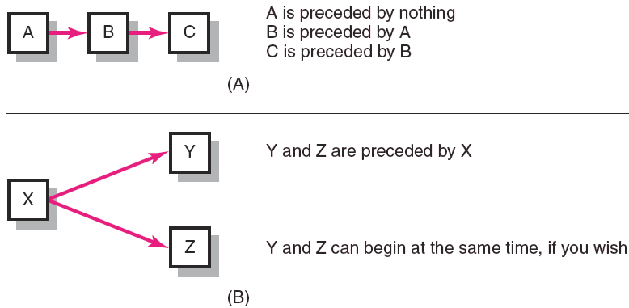
Activity on Node (AON)
6–<number>

Slide 12
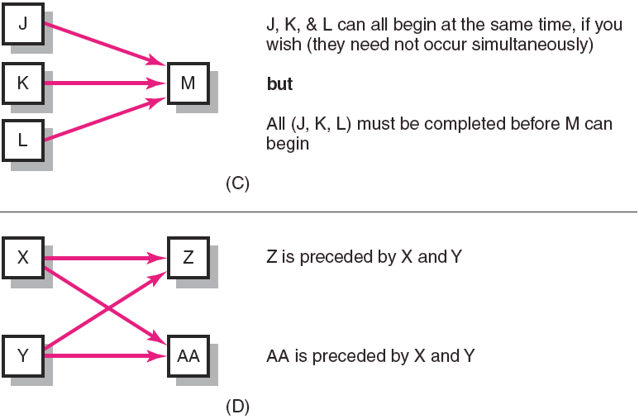
Activity on Node (AON)
6–<number>

Slide 13
Basic Rules to Follow in Developing
Project Networks
Networks typically flow from left to right.
An activity cannot begin until all preceding connected activities are complete.
Arrows indicate precedence and flow
and can cross over each other.
Each activity must have a unique identify number that is greater than any of its predecessor activities.
Looping is not allowed (recycling through a set of activities cannot take place)
Conditional statements are not allowed.
Use common start and stop nodes.
6–<number>

Slide 14
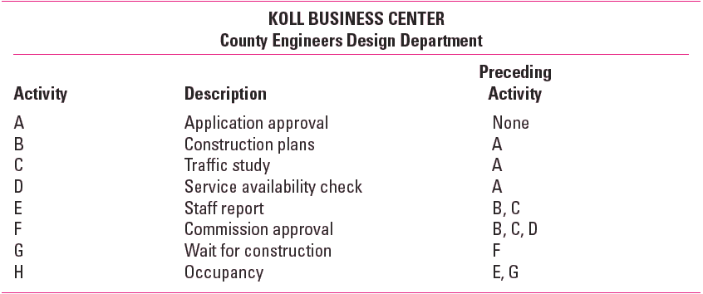
Network Information
6–<number>

Slide 15
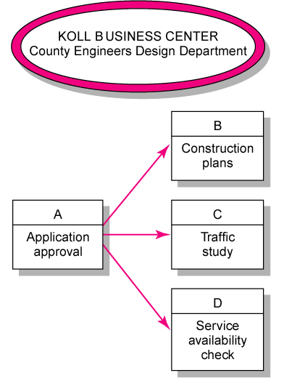
Koll Business Center – Partial Network
6–<number>

Slide 16
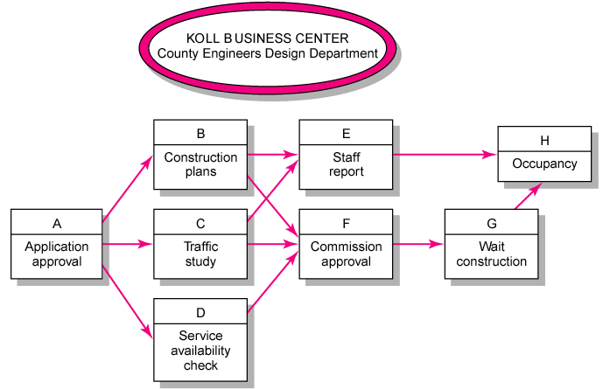
Koll business Center – Complete Network
6–<number>

Slide 17
Network Computation Process
Forward Pass—Earliest Times
  How soon can the activity start? (early start—ES)
  How soon can the activity finish? (early finish—EF)
  How soon can the project finish? (expected time—ET)
Backward Pass—Latest Times
  How late can the activity start? (late start—LS)
  How late can the activity finish? (late finish—LF)
  Which activities represent the critical path?
  How long can activity be delayed? (slack or float—SL)
6–<number>

Slide 18
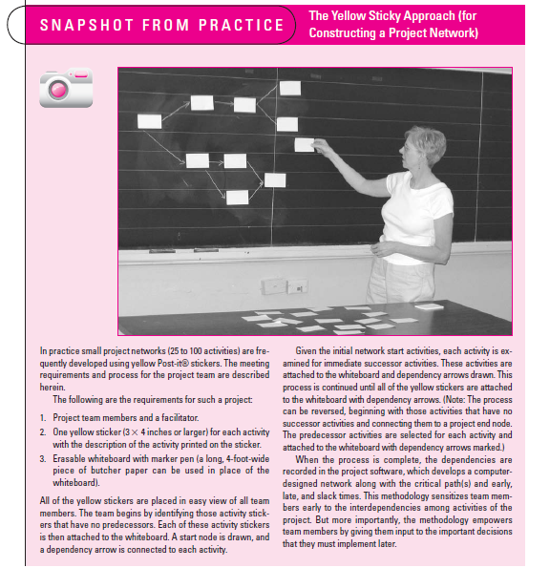
Snapshot from Practice
6–<number>

Slide 19
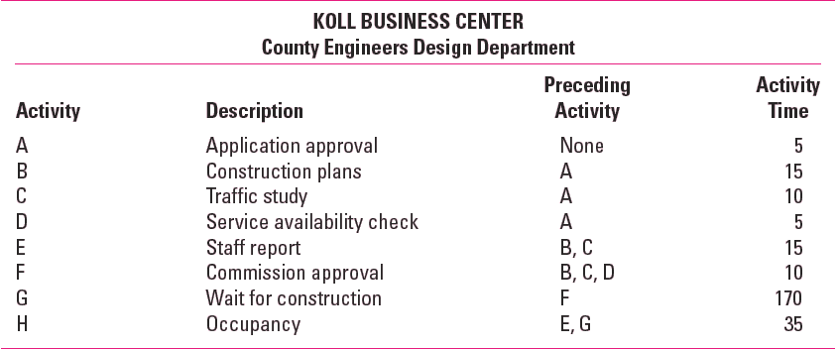
Network Information
6–<number>

Slide 20
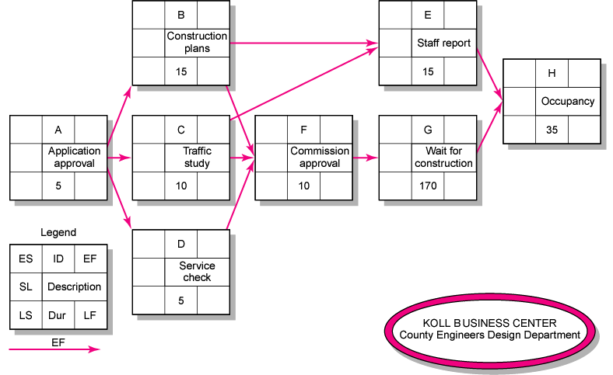
Activity-on-Node Network
6–<number>

Slide 21
Forward Pass Computation
Add activity times along each path in the network (ES + Duration = EF).
Carry the early finish (EF) to the next activity where it becomes its early start (ES) unless…
The next succeeding activity is a merge activity, in which case the largest EF of all preceding activities is selected.
6–<number>

Slide 22
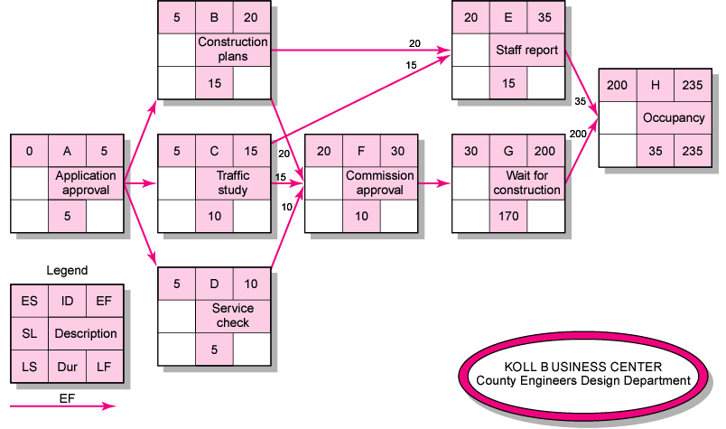
Activity-on-Node Network Forward Pass
6–<number>

Slide 23
Backward Pass Computation
Subtract activity times along each path in the network (LF - Duration = LS).
Carry the late start (LS) to the next activity where it becomes its late finish (LF) unless
The next succeeding activity is a burst activity, in which case the smallest LF of all preceding activities is selected.
6–<number>

Slide 24
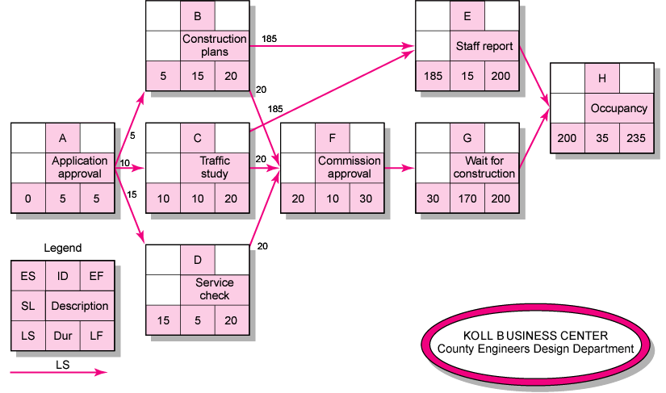
Activity-on-Node Network Backward Pass
6–<number>

Slide 25
Determining Slack
(Not All Slack is Equal)
Free Slack (or Float)
  The amount of time an activity can be delayed without delaying connected successor activities
  Tends to happen as the last activity in a path before a merge activity (when another path is the critical one).
Total Slack
  The amount of time an activity can be delayed without delaying the entire project
The critical path is the network path(s) that has (have) the least slack in common.
  This class will avoid the confusion of negative slack! … thus all projects will have their end activity have LF=EF
  So all critical path activities will have a total slack of 0.

Slide 26


Slack and Slackers: The Simplest Example of Free Slack
Take a 5 person marketing project –Team5
  Remy writes the requirements doc- which will take 2 days
  Polly can build the prototype from the requirements doc in 7 days
  Su needs 3 days to survey potential consumers once he has the requirements doc.
  Al gets to analyze the consumer responses to the survey, which will take 2 days.
  Fatima prepares the final presentation to management, so she needs the prototype and the analysis from the survey. This will take 2 days.
Which activities are:
  Critical
  Have total slack but not free slack
  Have free slack
Who can disappear for a day in the middle of their project and annoy the fewest people?

Slide 27


Extended Network Techniques to Come Close to Reality
Laddering
  Activities are broken into segments so the following activity can begin sooner and not delay the work.
Lags
  The minimum amount of time a dependent activity must be delayed to begin or end
    Lengthy activities are broken down to reduce the delay in the start of successor activities.
    Lags can be used to constrain finish-to-start, start-to-start, finish-to-finish, start-to-finish, or combination relationships.
– MS project defaults to finish-to-start, but represents all the others, as well…

Slide 28
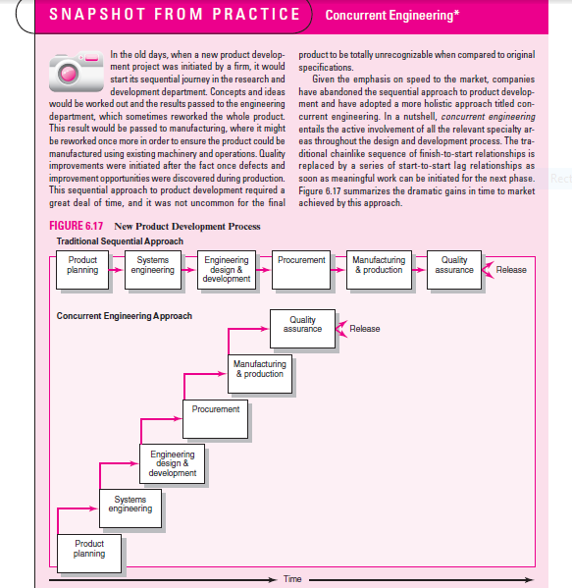

Slide 29
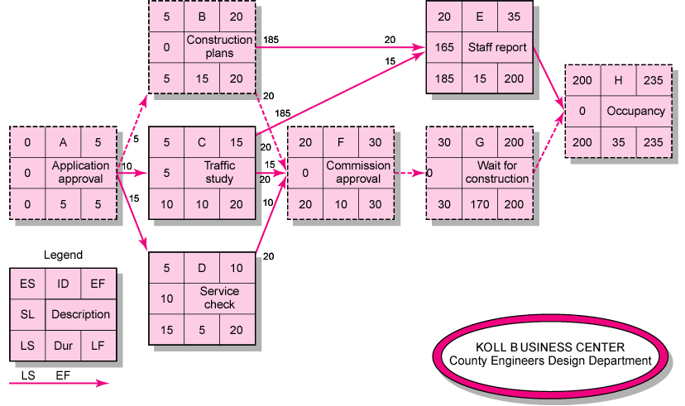
Activity-on-Node Network with Slack
6–<number>

Slide 30
Determining Free Slack (or Float)
Free Slack (or Float)
  Is the amount of time an activity can be delayed after the start of a longer parallel activity or activities.
  Is how long an activity can exceed its early finish date without affecting early start dates of any successor(s).
  Allows flexibility in scheduling scarce resources.
Sensitivity
  The likelihood the original critical path(s) will change once the project is initiated.
  The critical path is the network path(s) that has (have) the least slack in common.
6–<number>

Slide 31
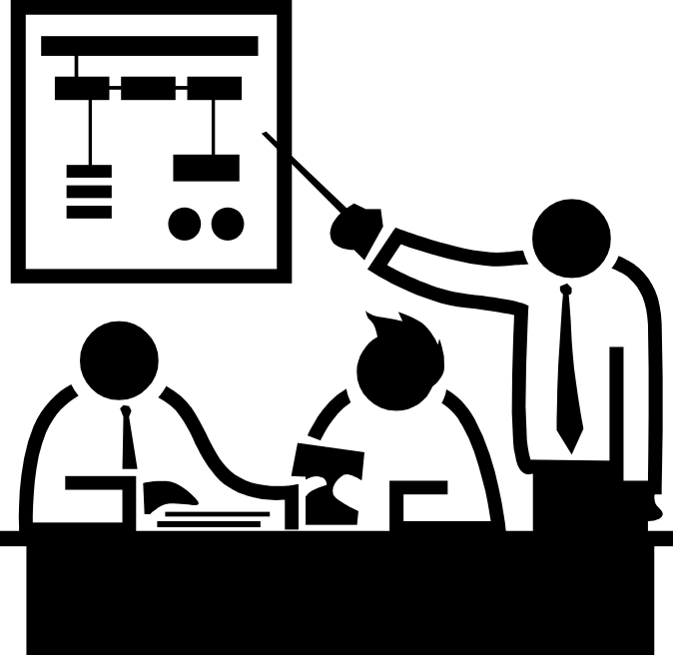
Practical Considerations
Network Logic Errors
Activity Numbering
Use of Computers to Develop Networks
Calendar Dates
Multiple Starts and Multiple Projects
6–<number>

Slide 32
Extended Network Techniques
to Come Close to Reality
Laddering
  Activities are broken into segments so the following activity can begin sooner and not delay the work.
Lags
  The minimum amount of time a dependent activity must be delayed to begin or end.
    Lengthy activities are broken down to reduce the delay
    in the start of successor activities.
    Lags can be used to constrain finish-to-start, start-to-start, finish-to-finish, start-to-finish, or combination relationships.
6–<number>

Slide 33
Hammock Activities
Hammock Activity
  An activity that spans over a segment of a project.
  Duration of hammock activities is determined
  after the network plan is drawn.
  Hammock activities are used to aggregate
  sections of the project to facilitate getting
  the right amount of detail for specific sections
  of a project.
6–<number>

Slide 34
Key Terms
Activity
Activity-on-arrow (AOA)
Activity-on-node (AON)
Burst activity
Concurrent engineering
Critical path
Early and late times
Gantt chart
Hammock activity
Lag relationship
Merge activity
Network sensitivity
Parallel activity
Slack/float—total and free
6–<number>

